Slide 1
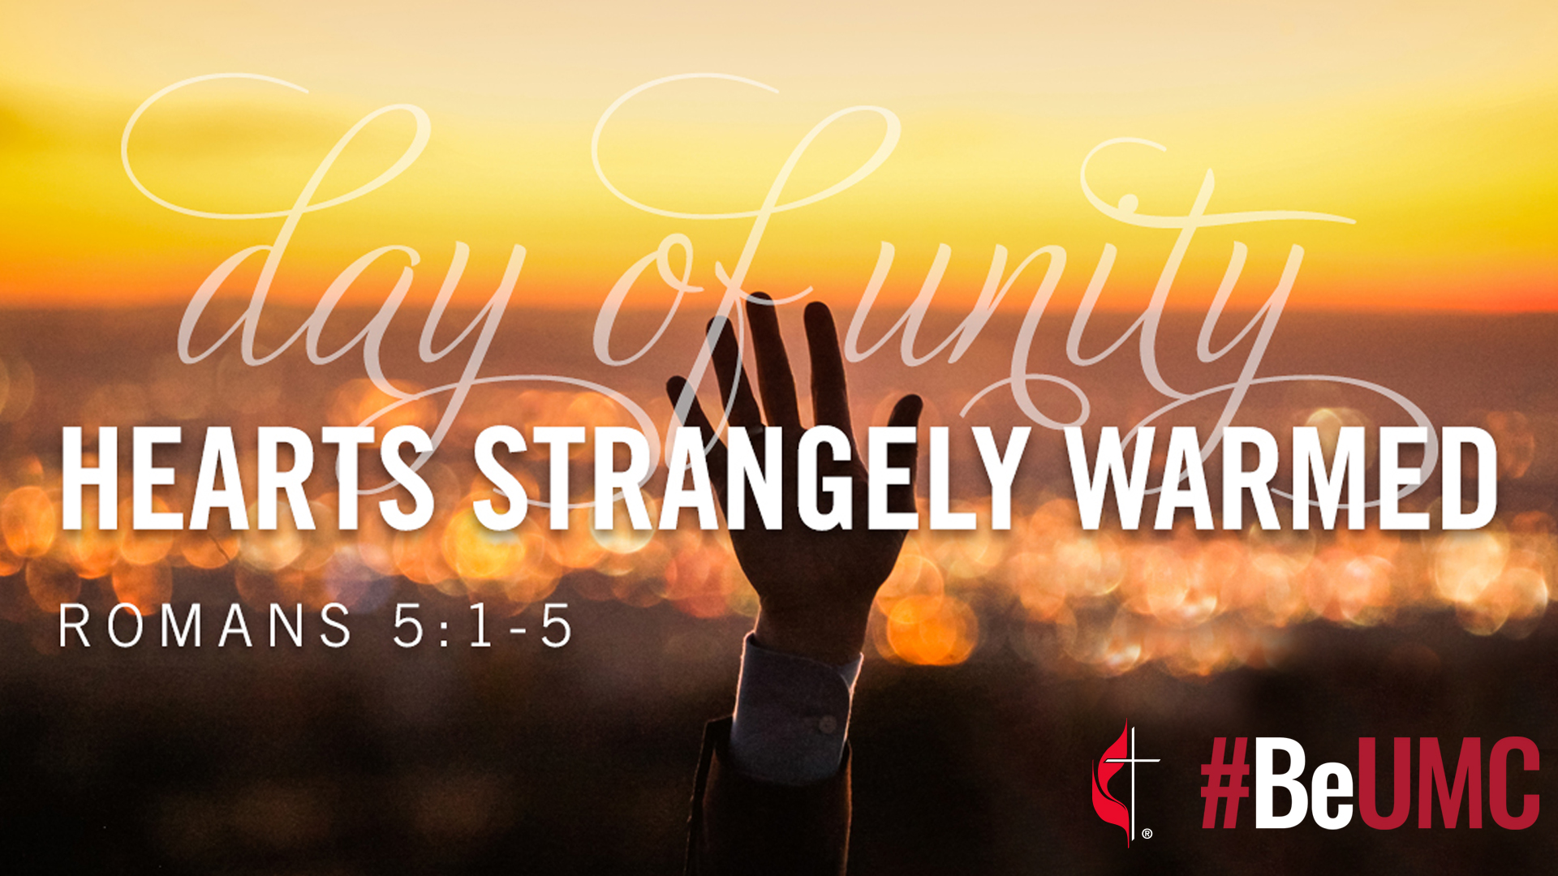

Slide 2

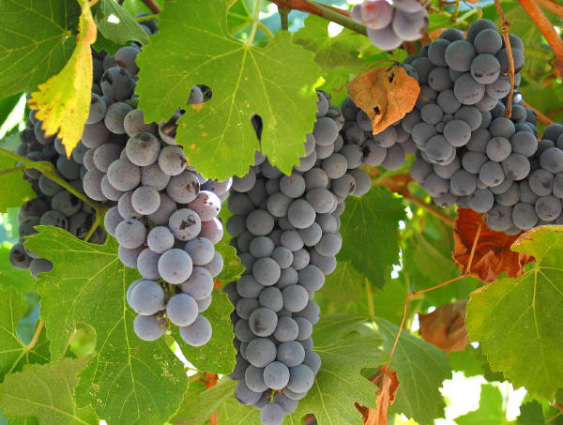
A Rediscovered Deep Connection

Slide 3
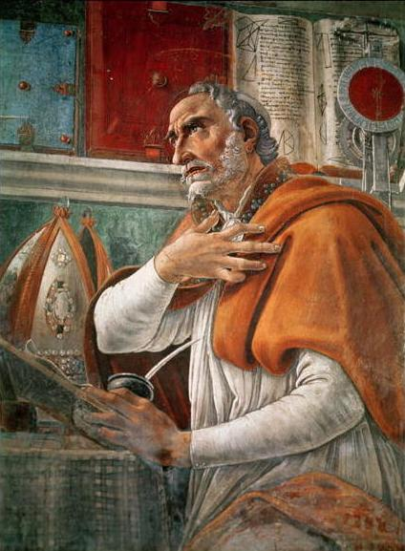
Augustine’s Restless Heart
“You have made us for yourself, and our hearts are restless until they find their rest in You.”

Slide 4
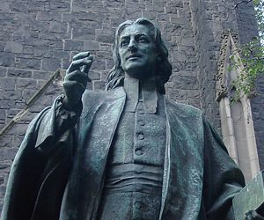
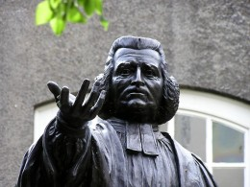
Refreshed Church with Two Brothers
John Wesley
Anglican preacher
Charles Wesley
Anglican poet

Slide 5
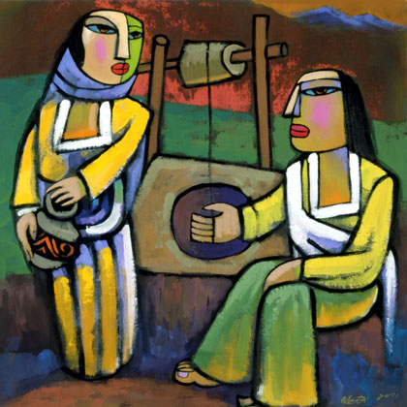
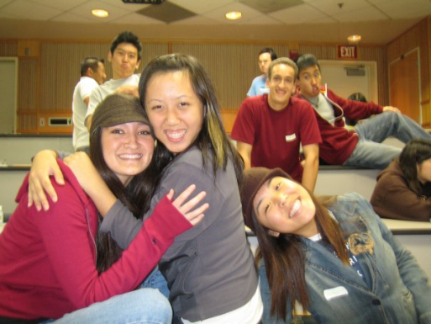
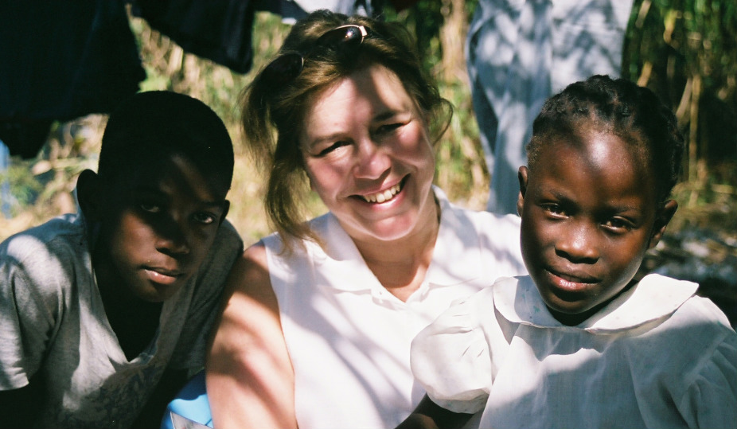
Grace, Community, & Vocation
The Gift of Grace
The Cultivation of Community
The Vitality of Vocation

Slide 6
The Gift of Grace

Slide 7
The Foundation of Grace
What shall I do my God to love?
My loving God to praise
The length, and breadth, and height to prove,
And depth of sovereign grace?
(Sung to the tune for Amazing Grace)

Slide 8
Your sovereign grace to all extends,
Immense and unconfined;
From age to age it never ends;
It spans all humankind.

Slide 9
Throughout the world
its breadth is known,
Wide as infinity;
So wide it never passed by one,
Or it had passed by me.

Slide 10

The Grace of Creation

Slide 11
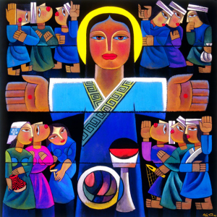
The Grace of Redemption

Slide 12
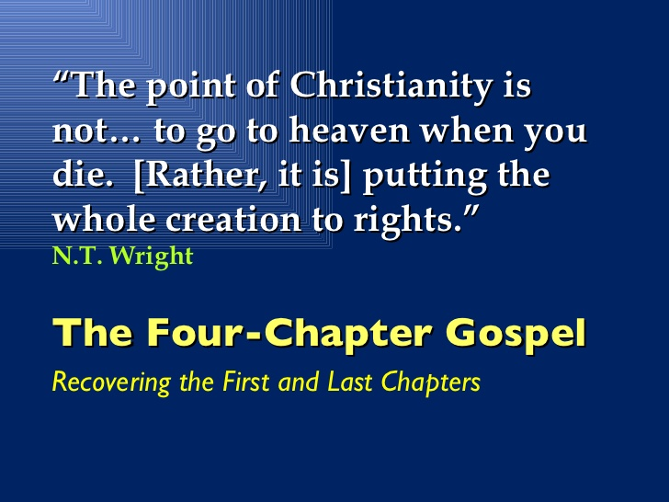
The Four-Chapter Gospel
Creation
Fall
Redemption
Restoration

Slide 13

The Cultivation of Community

Slide 14
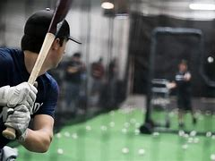
Community Shapes Practice/
Practice Defines Community

Slide 15
“Christian practices are not activities we do to make something spiritual happen in our lives. Nor are they duties we undertake to be obedient to God. Rather, they are patterns of communal action that create openings in our lives where the grace, mercy, and presence of God may be made known to us. They are places where the power of God is experienced. In the end, these are not ultimately our practices but forms of participation in the practice of God.”
- Craig Dykstra

Slide 16
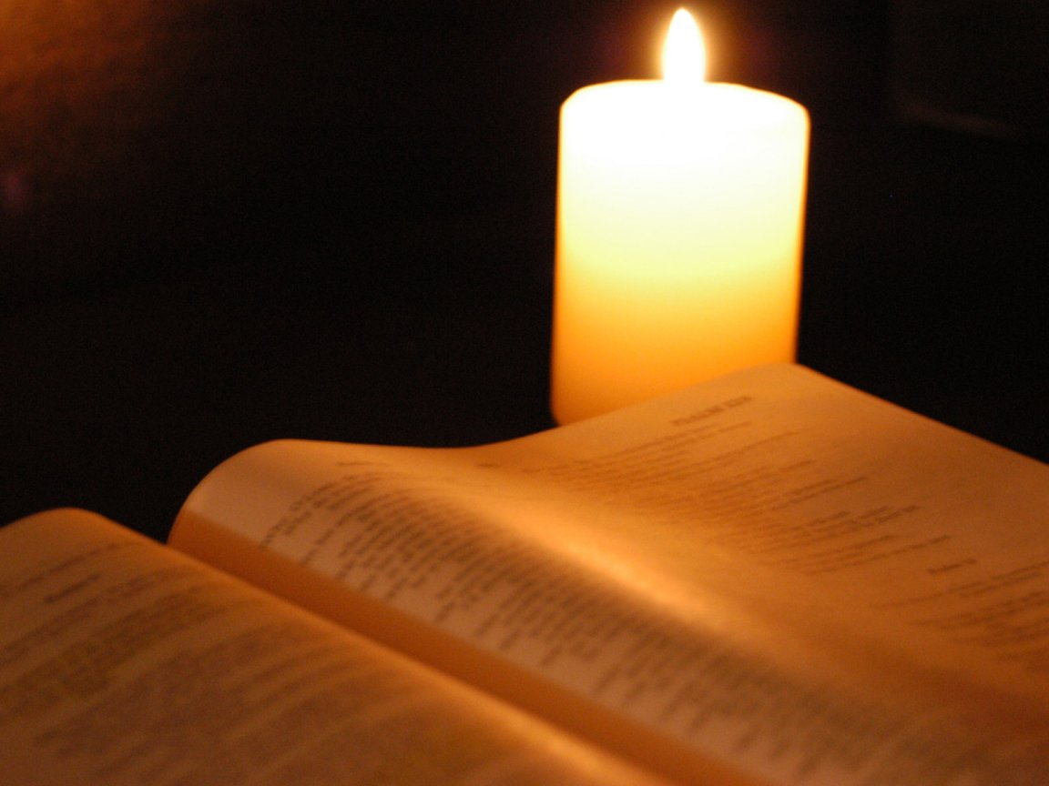
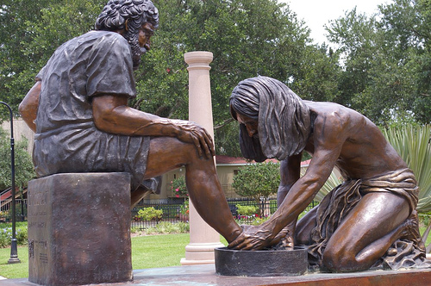
Refreshed Spiritual Practices
Works of Mercy
Works of Piety

Slide 17
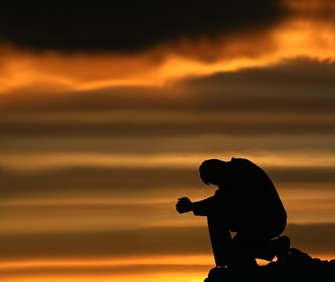
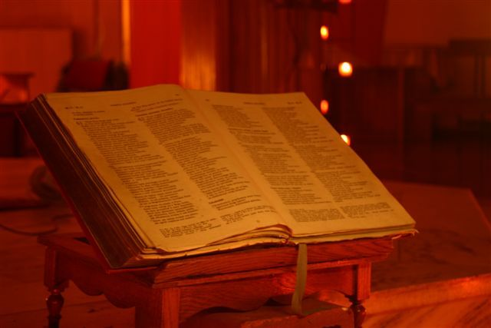
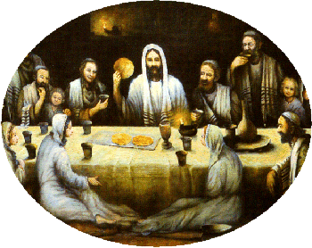
Works of Piety
Prayer
Immersion in Scripture
Eucharist

Slide 18
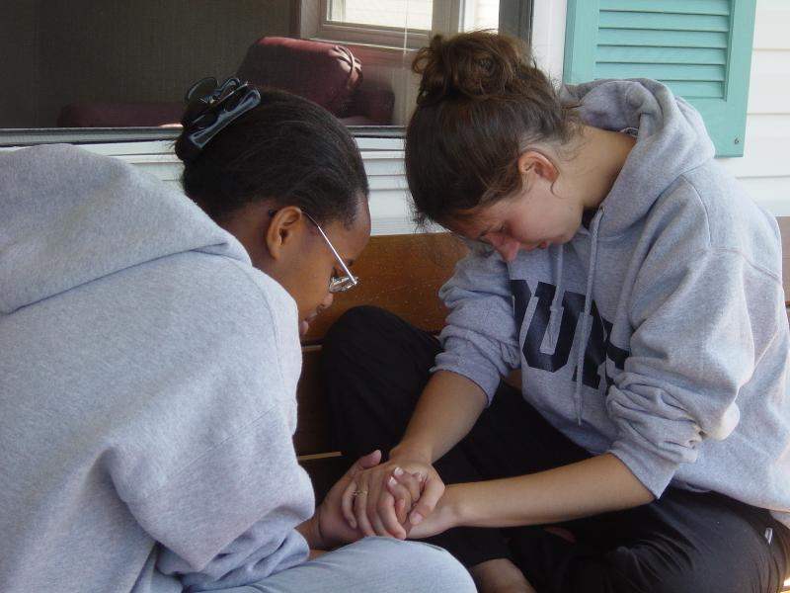
Prayer

Slide 19
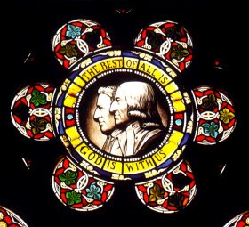
A Disciplined Life of Prayer
Morning Prayer & Evening Prayer
Recitation of Psalter
Lectio continua
Collection of “Office Hymns”

Slide 20
Pray, without ceasing pray
(Your Captain gives the word),
His summons cheerfully obey,
And call upon the Lord;
To God your every want
In instant prayer display;
Pray always; pray, and never faint;
Pray, without ceasing pray.
(Sung to the tune for This Is My Father’s World)

Slide 21
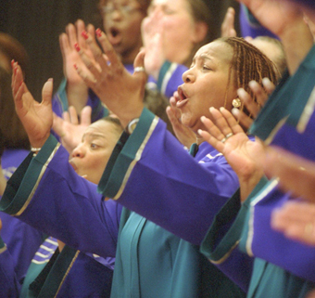
To Sing is to Pray Twice

Slide 22
Biblical Engagement

Slide 23
When quiet in my house I sit,
your book be my companion still;
My joy your sayings to repeat,
Talk o’er the records of your will,
And search the oracles divine
Till every heartfelt word be mine.
(Sung to the tune for Faith of Our Fathers)

Slide 24
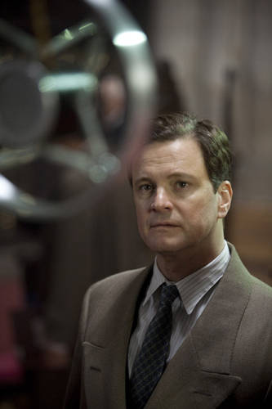
The Power of the Word
Words shape us and give us our identity
Human interaction based on spoken words and acted signs – speaking and doing

Slide 25
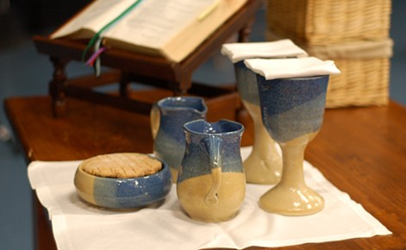
Eucharist

Slide 26
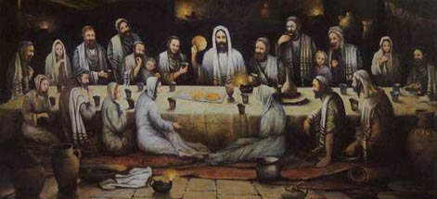
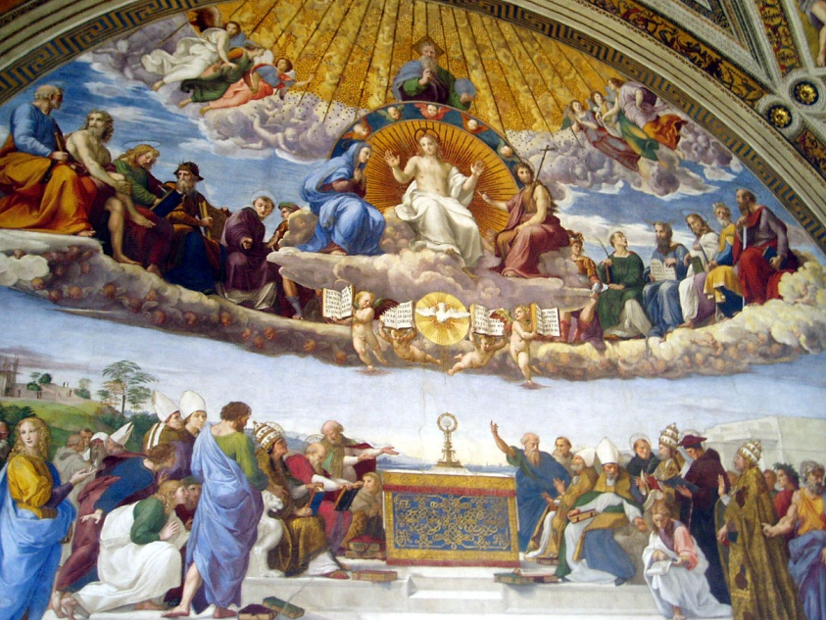
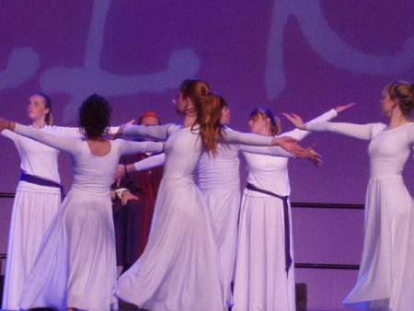
The Table and Time

Slide 27
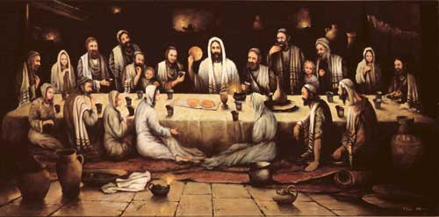
The Lord’s Supper: A Memorial

Slide 28
Endless scenes of wonder rise
With that mysterious tree,
Crucified before our eyes
Where we our Maker see:
Jesus, Lord, what hast Thou done?
Publish we the death Divine,
Stop, and gaze, and fall, and own
Was never love like Thine!

Slide 29
Never love nor sorrow was
Like that my Jesus showed;
See Him stretched on yonder cross,
And crushed beneath the load!
Now discern the Deity,
Now His heavenly birth declare;
Faith cries out, ’Tis He, ’tis He,
My God, that suffers there!

Slide 30
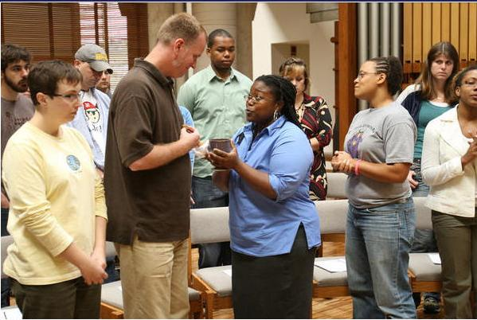
Eucharist: A Celebration

Slide 31
Jesu, we thus obey
Thy last and kindest word,
Here in Thine own appointed way
We come to meet our Lord:
The way Thou has enjoined
Thou wilt therein appear;
We come with confidence to find
Thy special presence here.

Slide 32
Our hearts we open wide,
To make the Savior room;
And lo! the Lamb, the Crucified,
The sinner’s Friend, is come!
His presence makes the feast;
And now our bosoms feel
The glory not to be expressed,
The joy unspeakable.

Slide 33
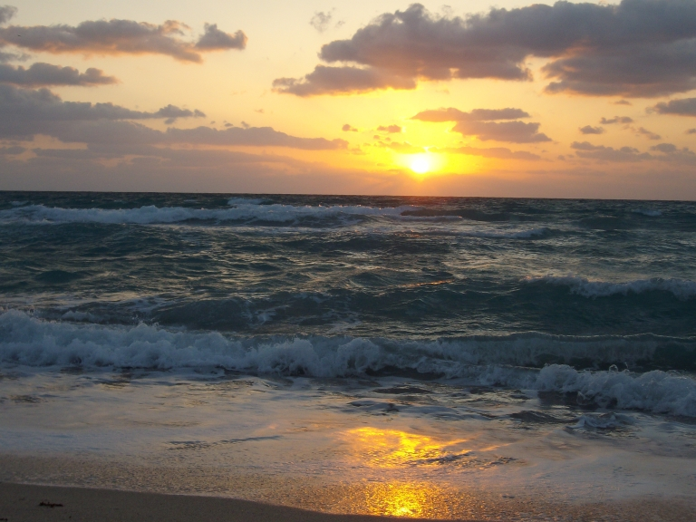
Holy Communion: A Pledge

Slide 34
How glorious is the life above,
Which in this ordinance we taste;
That fulness of celestial love,
That joy which shall for ever last!
The light of life eternal darts
Into our souls a dazzling ray,
A drop of heaven o’erflows our hearts,
And deluges the house of clay.

Slide 35
Sure pledge of ecstasies unknown
Shall this Divine communion be;
The ray shall rise into a sun,
The drop shall swell into a sea.

Slide 36
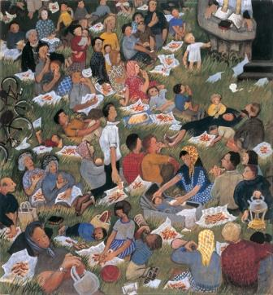
From Table to Mission

Slide 37
The Vitality of Vocation

Slide 38
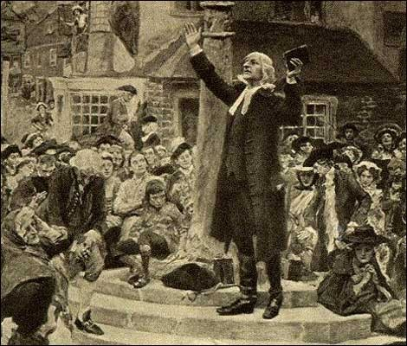
Rediscovering a Mission-Church

Slide 39
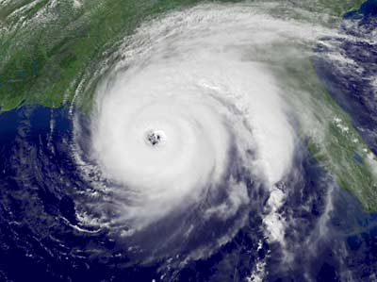

Slide 40
To love is all my wish,
I only live for this:
Grant me, Lord, my heart’s desire,
There by faith for ever dwell:
This I always will require
Thee and only thee to feel.
(Sung to the tune of Rock of Ages)

Slide 41
Thy pow’r I pant to prove
Rooted and fixed in love,
Strengthened by thy Spirit’s might,
Wise to fathom things divine,
What the length and breadth and height,
What the depth of love like thine.

Slide 42
Ah! Give me this to know
With all thy saints below.
Swells my soul to compass thee,
Gasps in thee to live and move,
Filled with all the deity,
All immersed and lost in love!

Slide 43
