Slide 1
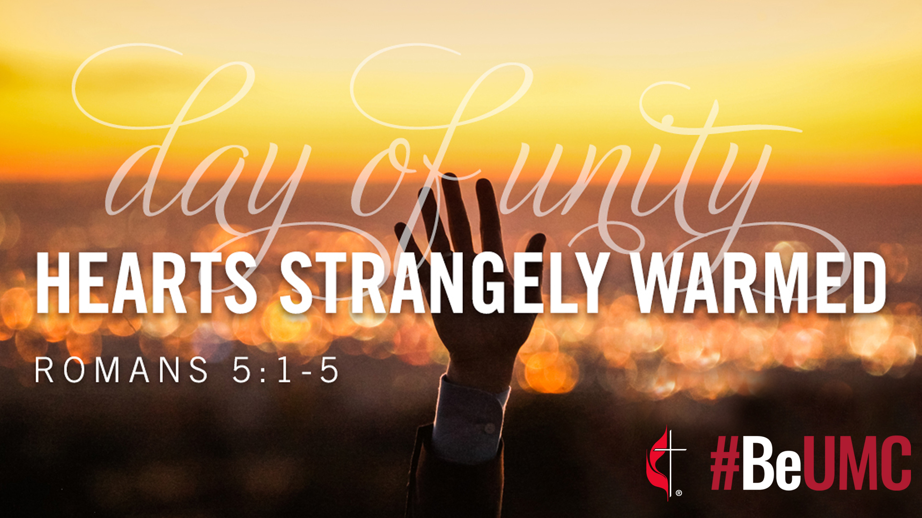

Slide 2


A Refreshed Wesleyan Vision

Slide 3
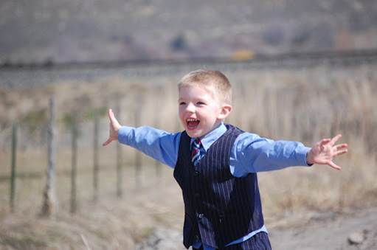
Wide Embrace

Slide 4
Lord Jesus Christ, you stretched out your arms of love on the hard wood of the cross that everyone might come within the reach of your saving embrace: So clothe us in your Spirit that we, reaching forth our hands in love, may bring those who do not know you to the knowledge and love of you; for the honor of your Name. Amen.

Slide 5
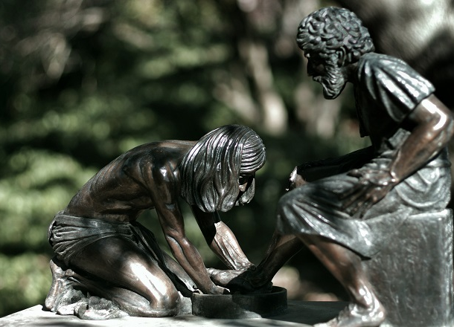
Christlike Practice

Slide 6
If so low a child as I
May to your great glory live,
All my actions sanctify,
All my words and thoughts receive:
Claim me for your service, claim
All I have and all I am.
(Sung to the tune for Rock of Ages)

Slide 7
Take my soul and body’s powers,
Take my memory, mind, and will,
All my goods, and all my hours,
All I know, and all I feel,
All I think, and speak, and do;
Take my heart and make it new.

Slide 8
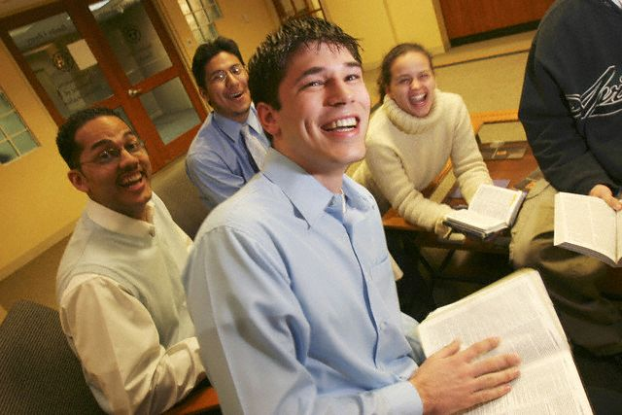
Scriptural Dynamism

Slide 9
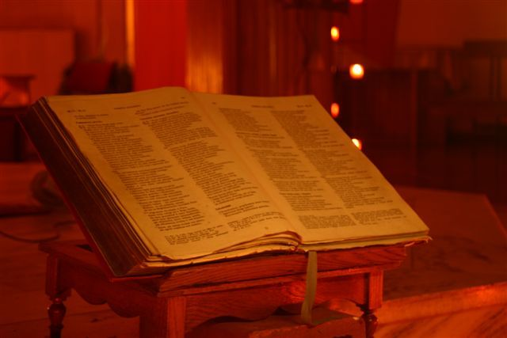

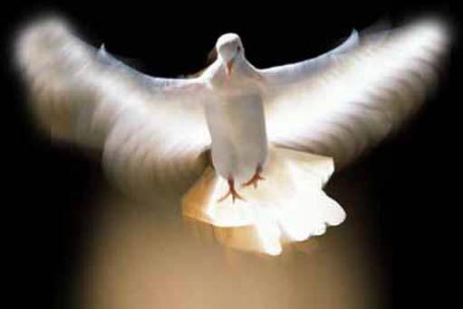
Engaging Scripture as Wesleyans
A Wesleyan Spiritual Paradigm
Living Word

Slide 10
While in thy word we search for thee,
(We search with trembling awe)
Open our eyes and let us see
The wonders of thy law.
Now let our darkness comprehend
The light that shines so clear;
Now the revealing Spirit send,
And give us ears to hear.
(Sung to the tune for O for a Thousand Tongues)

Slide 11

Spiritual Growth

Slide 12
Who marked their growth in grace? Who advised and exhorted them from time to time? Who prayed with them and for them as they had need? This, and this alone, is Christian fellowship. But, alas! Where is it to be found? Look east or west, north or south; name what parish you please. Is this Christian fellowship there? Rather, are not the bulk of the parishioners a mere rope of sand? What Christian connection is there between them? What intercourse in spiritual things? What watching over each other’s souls? What bearing of one another’s burdens? . . . We introduce Christian fellowship where it was utterly destroyed. And the fruits of it have been peace, joy, love, and zeal for every good word and work. - John Wesley

Slide 13
Enlarge, inflame, and fill my heart
With growing, boundless love divine,
So shall I all my strength exert,
And love all with a zeal like thine.
(Sung to the tune of When I Survey )

Slide 14
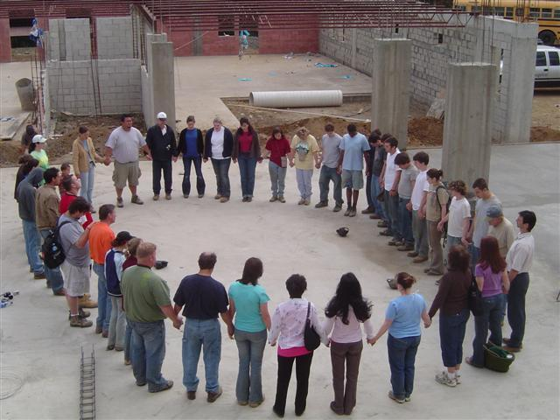
Missional Character

Slide 15
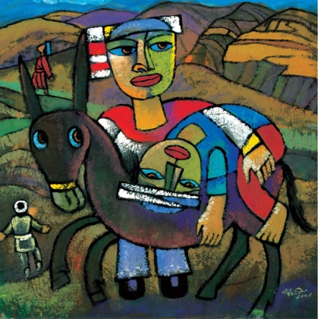
Works of Mercy: Compassion

Slide 16
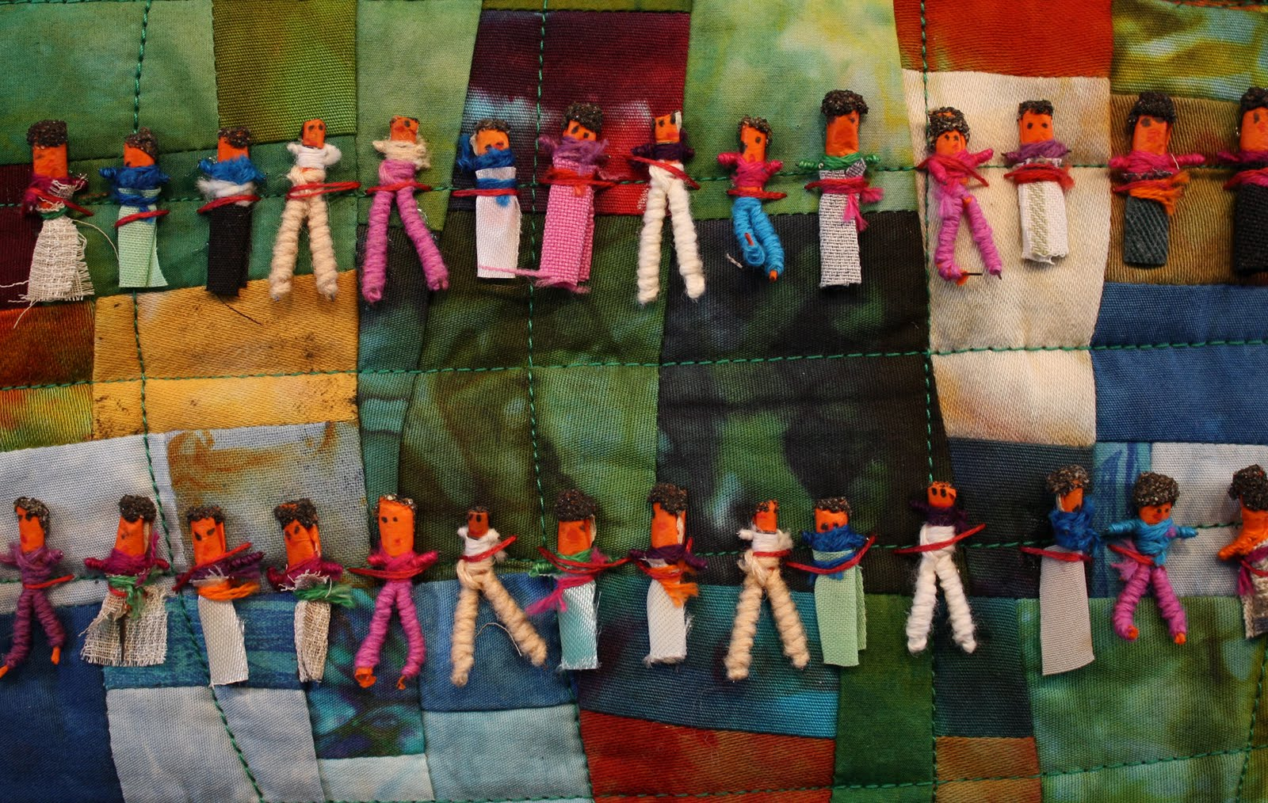
Works of Mercy: Justice

Slide 17

zoeempowers.org & Human Flourishing

Slide 18
The church of Christ, in every age
Beset by change but Spirit-led,
Must claim and test its heritage
And keep on rising from the dead.
Then let the servant church arise,
A caring church that longs to be
A partner in Christ’s sacrifice,
And clothed in Christ’s humanity.
(Sung to the tune for Forth in Thy Name)

Slide 19
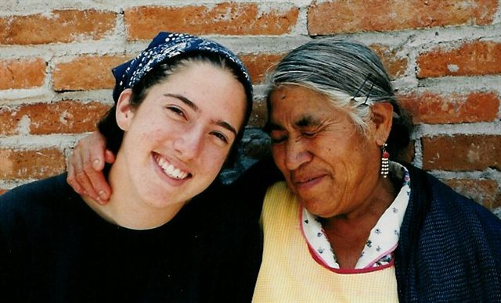
We have no mission but to serve
In full obedience to our Lord,
To care for all, without reserve,
And spread his liberating word.

Slide 20
The Recovery of True Religion
“What is true religion then? It is easy to answer. It lies in one single point. It is neither more nor less than love. It is the love that fulfills the law—love that flows from a pure heart. True religion is the love of God and our neighbor; that is, every human being. This love, ruling the whole life, shaping all our attitudes and dispositions, directing all our thoughts, words, and actions, is pure and faultless religion.”
- John Wesley

Slide 21
A Lyrical Prayer for a Refreshed United Methodist Vision
Come, thou holy God and true!
Come, and my whole heart renew;
Take me now, possess me whole,
Form the Savior in my soul:
Refrain: Love immense, and unconfined,
Love to all of humankind.
(Sung to the tune used for For the Beauty of the Earth)

Slide 22
Happy soul, whose active love
Emulates the Blessed above,
In thy every action seen,
Sparkling from the soul within:
Refrain: Love immense, and unconfined,
Love to all of humankind.

Slide 23
Love, which willest all should live,
Love, which all to all would give,
Love, that over all prevails,
Love, that never, never fails:
Refrain: Love immense, and unconfined,
Love to all of humankind.

Slide 24
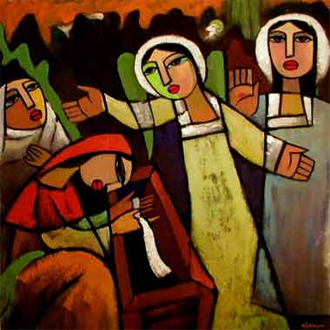
Offer Them Christ

