Slide 1
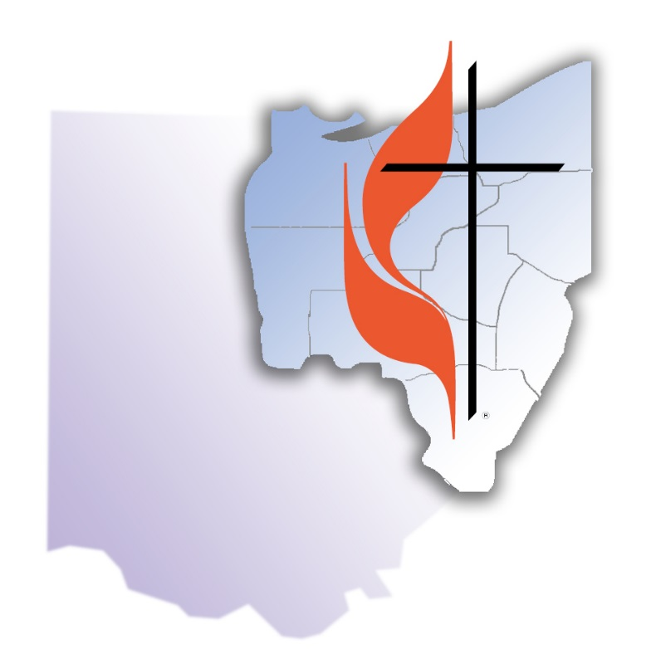

Coronavirus Aid, Relief and Economic Security Act
(CARES Act) PowerPoint Webinar
East Ohio Conference of The United Methodist Church
Vera Rebrovich, CPA
Director of Financial and Administrative Services

Slide 2

CARES Act Key Provisions
Paycheck Protection Program (PPP)
Expanded unemployment benefits
Delayed employer payroll taxes
Employee retention credit
Recovery rebates for individuals
Relief for retirement plan participants impacted by COVID-19
Provisions impacting individual and group health insurance coverage (telehealth, over-the-counter drugs, and feminine products)

Slide 3

CARES Act Key Provisions
The Act encompasses many components; only some of which will apply to clergy, lay employees, local churches and faith communities. We will only be discussing the PPP loan during this webinar. Many of the programs are mutually exclusive, meaning you can participate in one, but not all of them. Each situation will vary. This seminar is not intended to provide legal advice and you are encouraged to seek legal advice before committing to any of these programs.

Slide 4

Paycheck Protection Program (PPP)
Eligible churches will be able to borrow up to 2.5 times their 2019 average monthly payroll and benefits.
Loan proceeds can be used to cover payroll costs including benefits, interest on pre-existing debt, rent, and utilities.
Payroll is capped at $100,000 per employee on an annualized basis.

Slide 5

Paycheck Protection Program (PPP)
If the church meets the employee retention requirements, up to 100% of the loan can be forgiven.
Loan proceeds must be used to cover the above-referenced expenses over the ten weeks after getting the loan.
Not more than 25% of the forgiven amount may be for non-payroll costs.
Your loan forgiveness will be reduced if you decrease your employee headcount.

Slide 6

Paycheck Protection Program (PPP)
Your loan forgiveness will be reduced if you decrease salaries and wages by more than 25% for any employee that made less than $100,000, annualized, in 2019.
You will need to submit a request to your lender in order to have your loan forgiven.
No collateral is required; personal loan guarantees are not required.

Slide 7

Paycheck Protection Program (PPP)
Please be aware:
You need to notify your district superintendent of your intentions.
The pastor and an official group/person in the church (church council, finance committee or trustees) must approve in advance applying for the loan in a teleconference and must keep minutes. These minutes must be on record with the DS. A Charge Conference held later could affirm this decision. Clergy should not sign the application on their own.
Only an authorized Small Business Administration (SBA) lender can process a PPP loan. If the bank you typically use is not an authorized SBA lender, ask for a referral to one that is.

Slide 8

Paycheck Protection Program (PPP)
Please be aware:
Obtain your lender’s application. There is a generic application online, but your bank may have a different application. Ask your lender for its form!
Generally speaking, you will need to collect . . .
2019 Financial statement, payroll records, and W-2’s;
List of current employees and payrates;
Most recent pension and healthcare billings;
    Most recent utility bills, and most recent mortgage and rent statements (if any).

Slide 9

Paycheck Protection Program (PPP)
Please be aware:
Make sure you have the correct signature on the loan application! In most instances this will be the chairperson of your church’s Board of Trustees.
Follow your lender’s instructions for completing the documents; i.e., either bring everything in to their office or apply online.

Slide 10

Paycheck Protection Program (PPP)
Please be aware:
Once you’ve applied, make sure you understand the approval process; when will you hear you’ve been approved and how will you receive the loan proceeds? Make sure you understand when the clock starts ticking for repayment: from the date of submission, from the date of approval or from the date the loan proceeds are received?
Record that date!

Slide 11

Paycheck Protection Program (PPP)
Please be aware:
Track carefully how the loan money is spent over the next weeks from the date you have recorded above. See the fourth slide for the ways the funds can be used.
Submit all the documentation to get all or most of the loan forgiven.

Slide 12

Paycheck Protection Program (PPP)
Please be aware:
If any part of the loan is not forgiven, the loan will bear interest at the rate of 1.0% fixed rate. Loan payments will be deferred for six months, but interest will accrue during that period of time. The loan must be paid back within two years, but can be paid off early with no prepayment penalty.
Following this slide is a review of a generic SBA PPP loan application. The loan application your lender uses may be different.

Slide 13
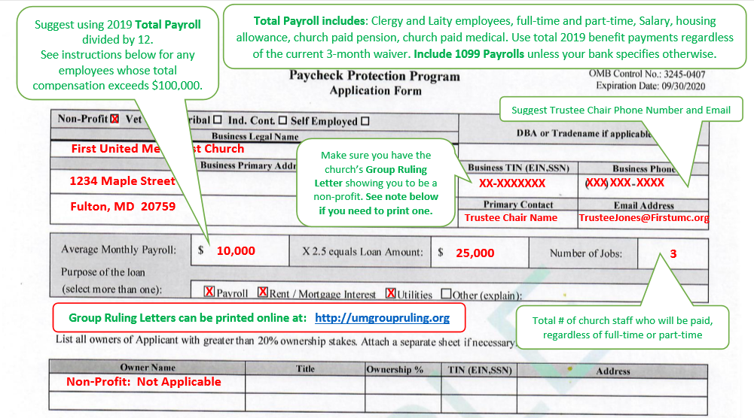


Slide 14
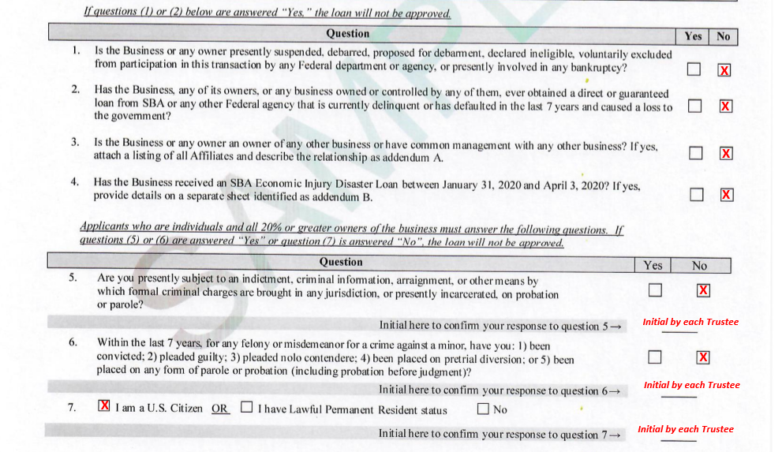


Slide 15
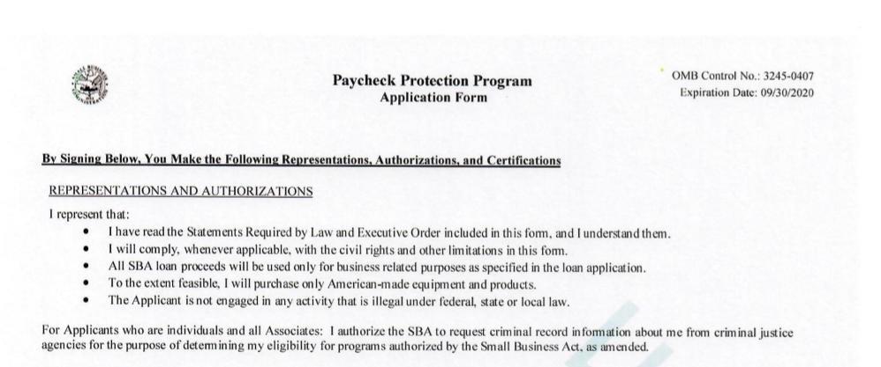


Slide 16
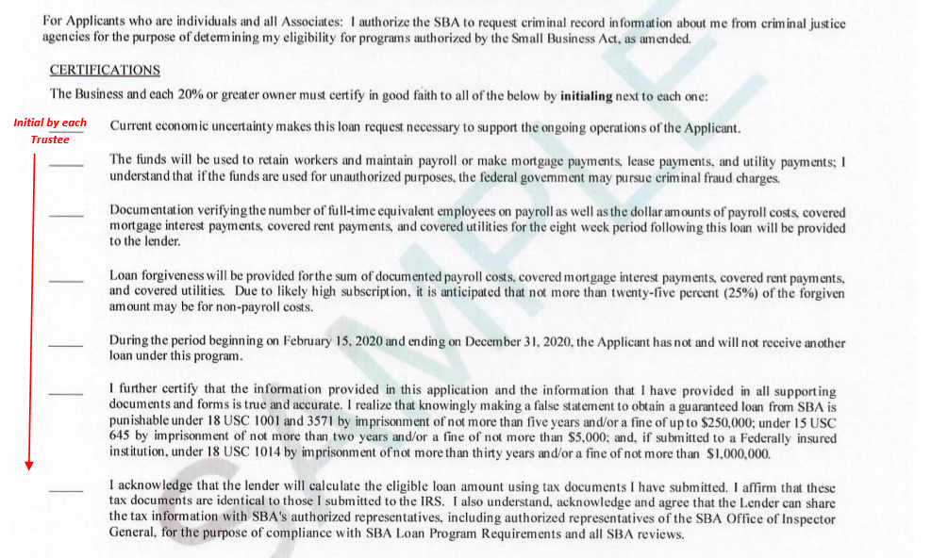


Slide 17
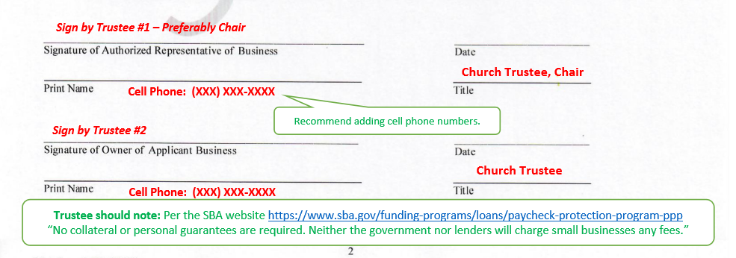


Slide 18
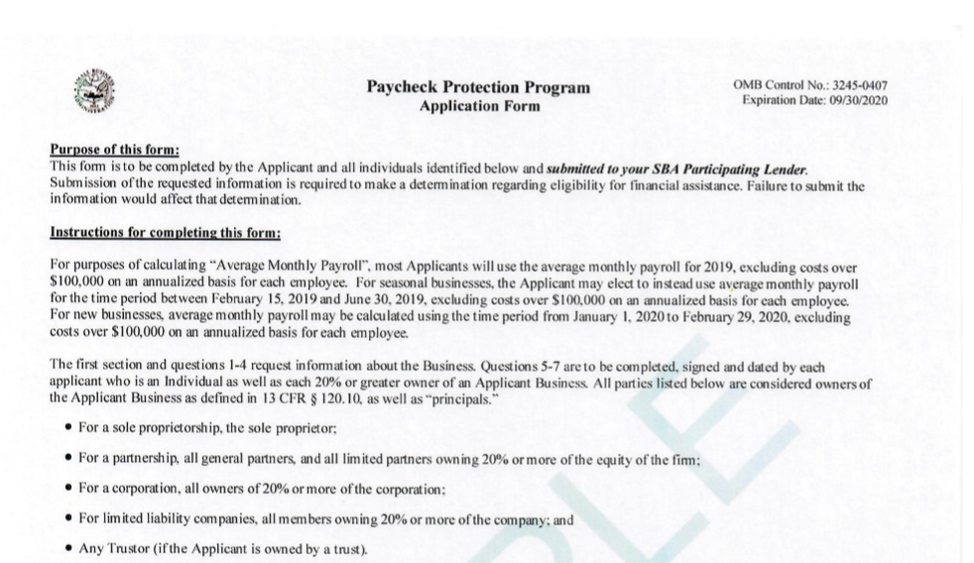


Slide 19
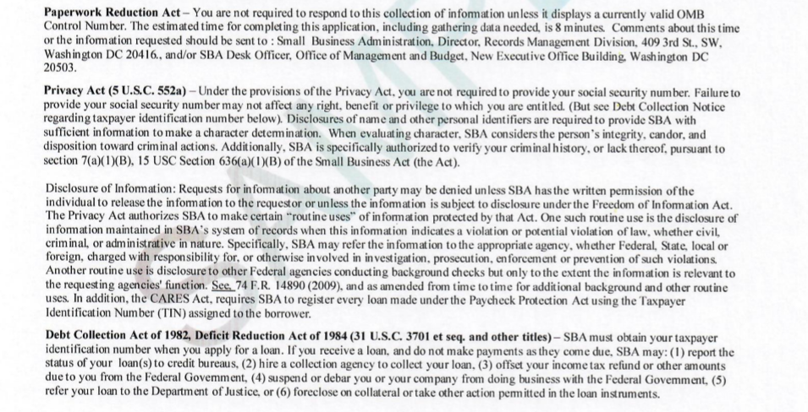


Slide 20
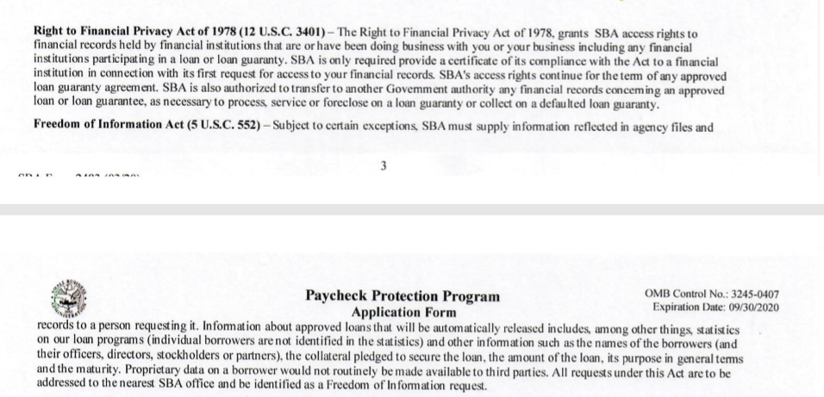


Slide 21
